Slide 1
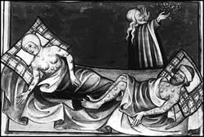
What is happening in this picture?
These men have caught the "Black Death!"

Slide 2
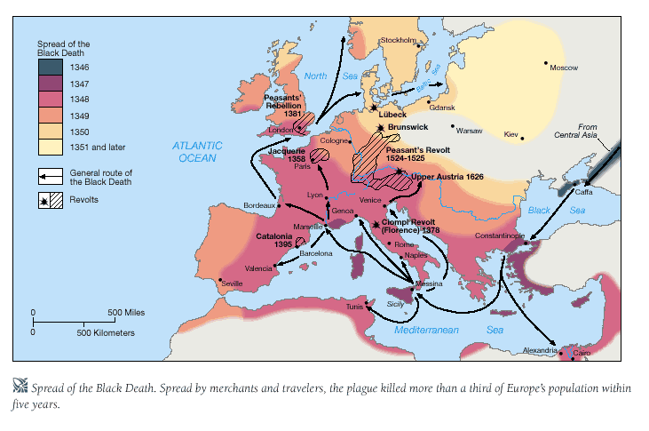
Between 1346 and 1351, the “Black Death” spread through Europe with terrifying speed. Over 25 million people (That’s 1 out of every 3) died in absolute agony within 5 days of contracting the disease. The people of Europe could not understand how the disease was spread. Nobody knew…
...What caused the "Black Death?"

Slide 3
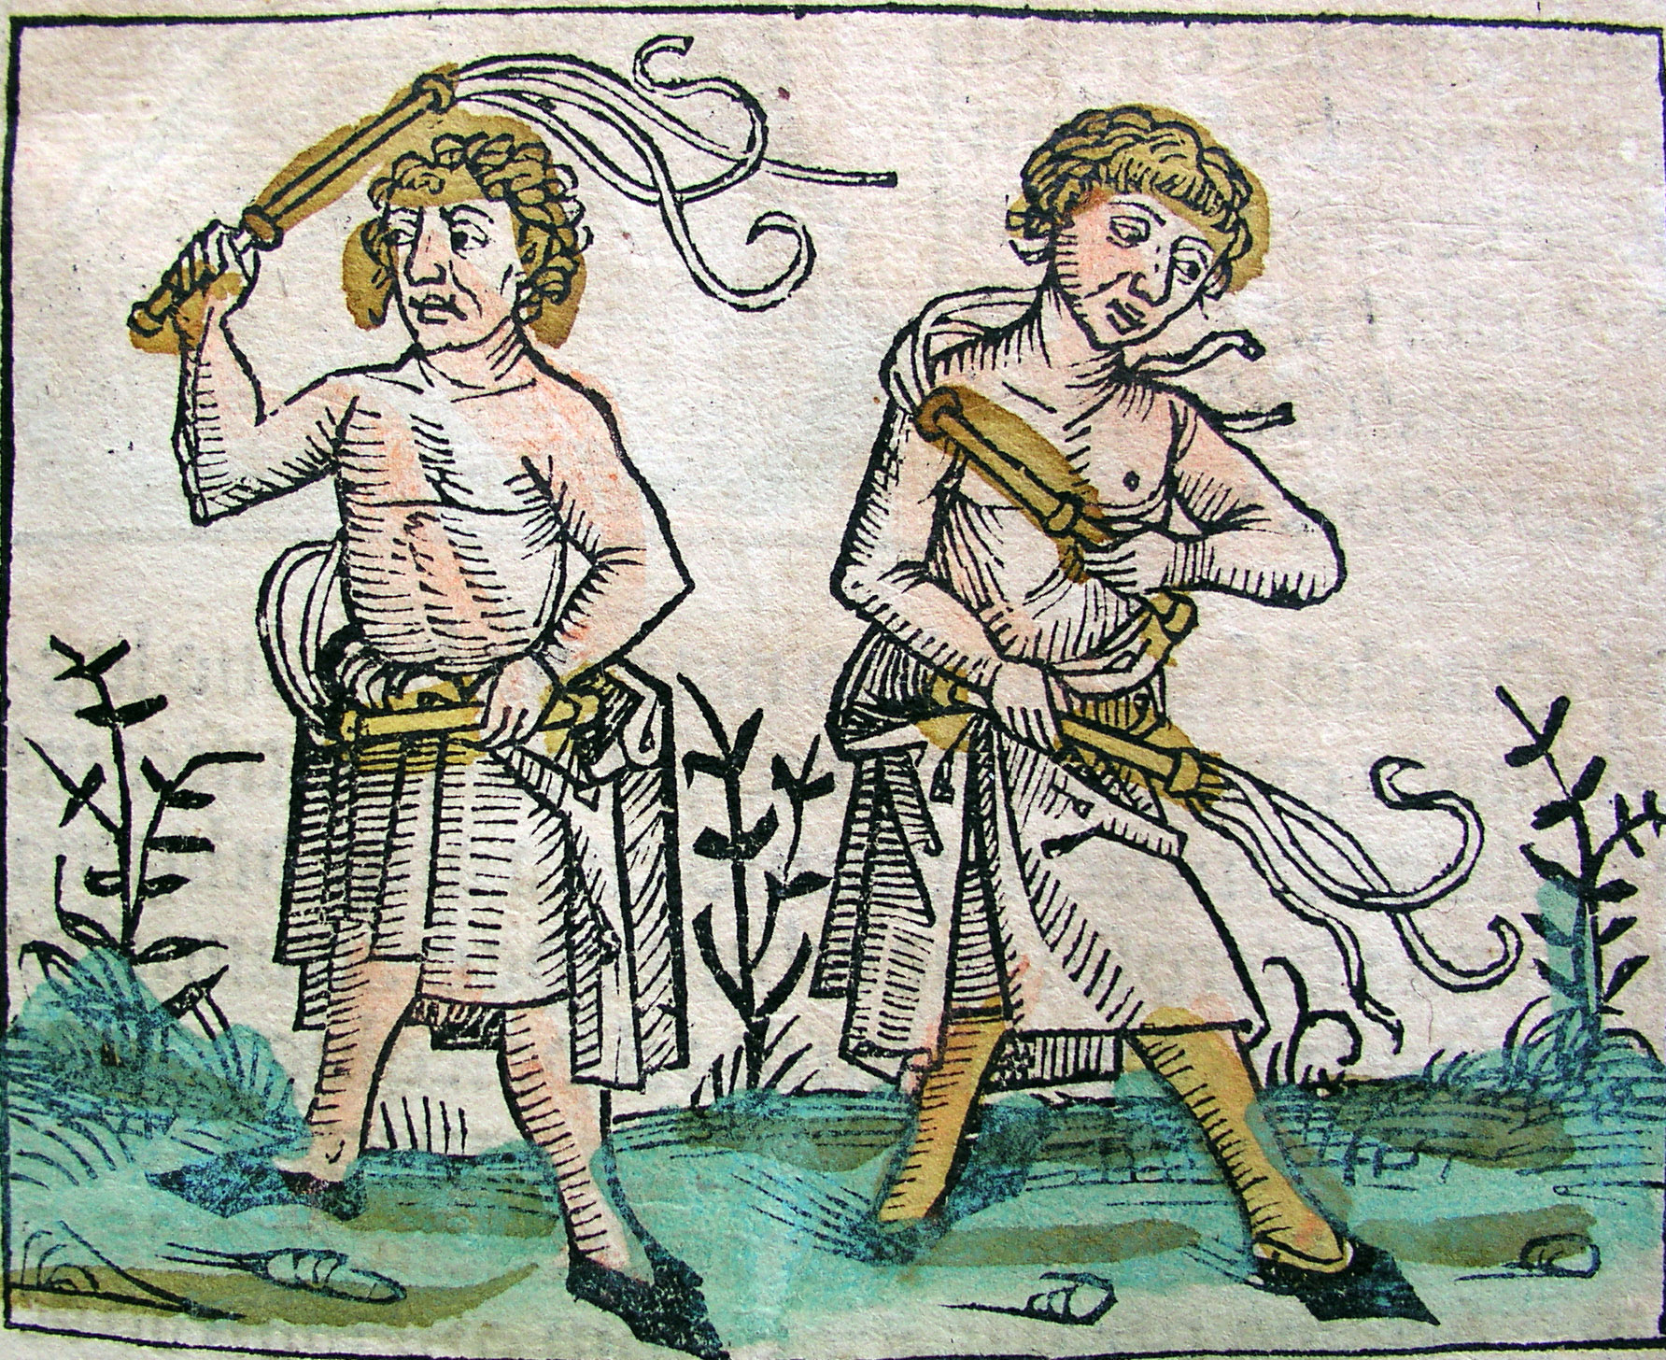

Slide 4
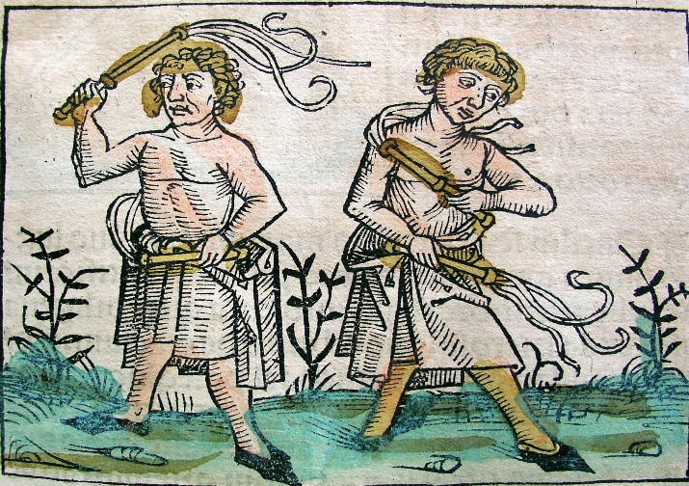
Sent by God!
Some people believed that the “Black Death” was a terrible punishment from God. They thought that God was angry with everybody for the terrible sins that they had been committing.
People who believed this were known as “flagellants.” They decided to punish themselves for the sins they had committed by whipping themselves brutally so that God wouldn’t need to punish them with the “Black Death!”
Unfortunately, their wounds became so infected that they caught the “Black Death” quicker than anybody else!

Slide 5
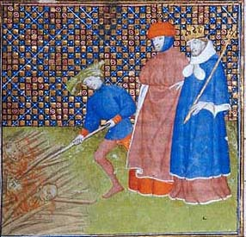

Slide 6
Person to Person!
Some people believed that the “Black Death” was spread from person to person by touch.
People who believed this would often burn the bodies of the plague victims so that nobody would have to touch their bodies and risk catching the disease.
In extreme circumstances, they would brick up the doors and windows to every home that had a plague victim inside. This stopped the “Black Death” from spreading, but it also killed many people who didn’t even have the disease!

Slide 7
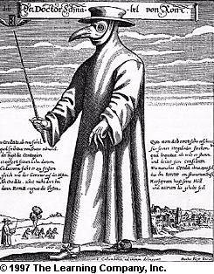


Pomander.
Posies.

Slide 8
Bad Air!
Some people believed that the “Black Death” was caused by breathing in foul or unpleasant smells.
People who believed this would make sure that they carried “pomanders” or “posies” with them wherever they went, so that they wouldn’t smell anything unpleasant that could cause the “Black Death.”
They made sure that dead plague victims were quickly buried so that nobody would have to smell their rotting remains and risk catching the “Black Death.” Doctors wore masks containing flower petals so that they didn’t smell anything bad whilst treating their patients!

Slide 9

Now test yourself!
When did the “Black Death” begin to spread across Europe?
What was the name of people who whipped themselves to stop them catching the “Black Death?”
How would people who thought the “Black Death” spread from Person to Person stop the disease from spreading (2 ways)?
What sweet smelling objects would people keep with them if they thought the “Black Death” was spread by Bad Air (2 things)?

Slide 10
Aims of the Lesson:
To understand what different people in the Middle Ages believed caused the “Black Death.”
To explain how different people in the Middle Ages tried to stop the “Black Death” from spreading.

